Slide 1
PRESENTATION ON ECOMMERCE APPLICATION
BATCH 87
SUBMITTED BY:
Akash Anbalagan
Srikar Kalle
Aman Deep
Pratishruti Panda

Slide 2

INTRODUCTION
This is a simple e.com application which is concerned with buying and selling of handmade crats directly through internet . Now a days handmade crafts are one of the trending area in online shopping.so this will help people to purchase their favorite crats sitting at home within few minutes .

Slide 3
DESCRIPTION
This project contains different modules like
USER
Login
Home page
Cart
Payment
Logout
ADMIN
Add product
Customer Details

Slide 4
PROJECT WORKFLOW
First a user need to register himself by giving name , email , address , number and password .
Then user need to log in and from the home page need to add products to the cart.
After adding the product successfully user need to go to do the payment page and do it.
Once the payment made the ordering process completed and user may return to home page.
Admin can Add product and see customer details .

Slide 5
TECHNOLOGY USED
BACK-END
Spring mvc
FRONT-END
Html5 , Css3 , JavaScript , Bootstrap
DATABASE
MySQL
IDE USED
Eclipse , Visual Studio Code

Slide 6
WEB-PAGE WORKFLOW
User
Sign up/Log in
Home page
Cart page
Payment
Payment sucessfull
Log out

Slide 7
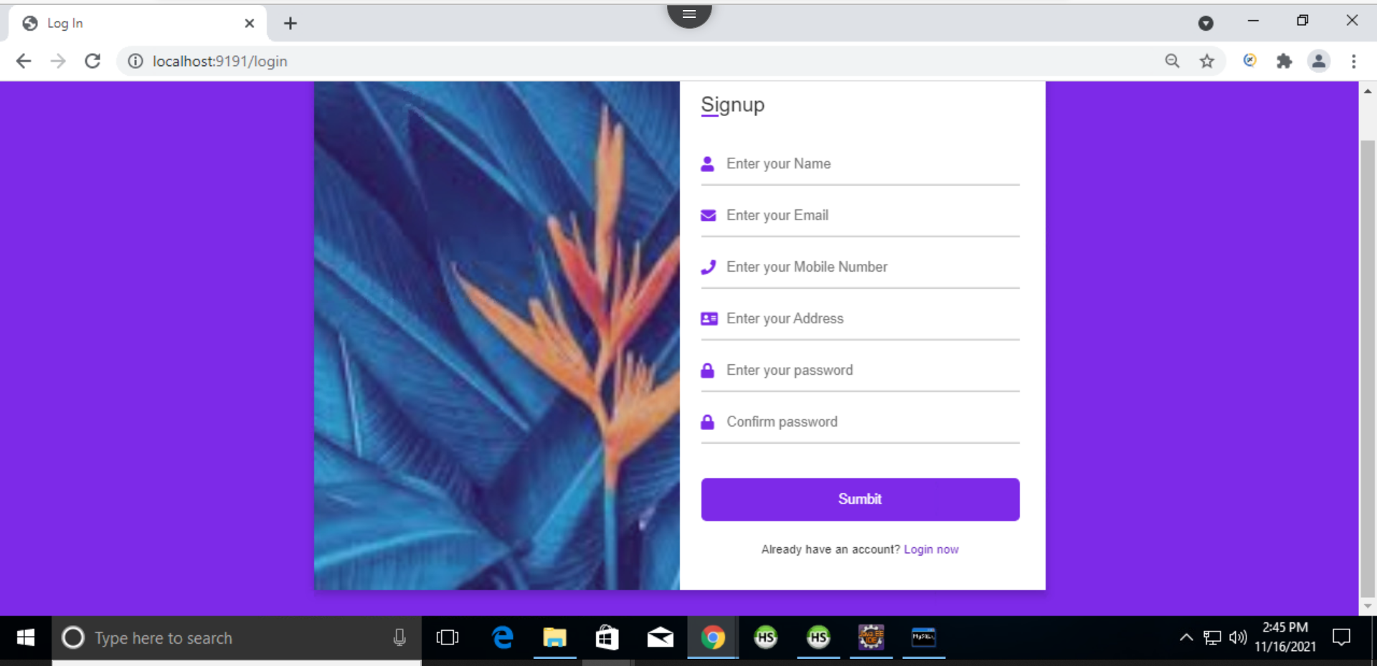


Slide 8
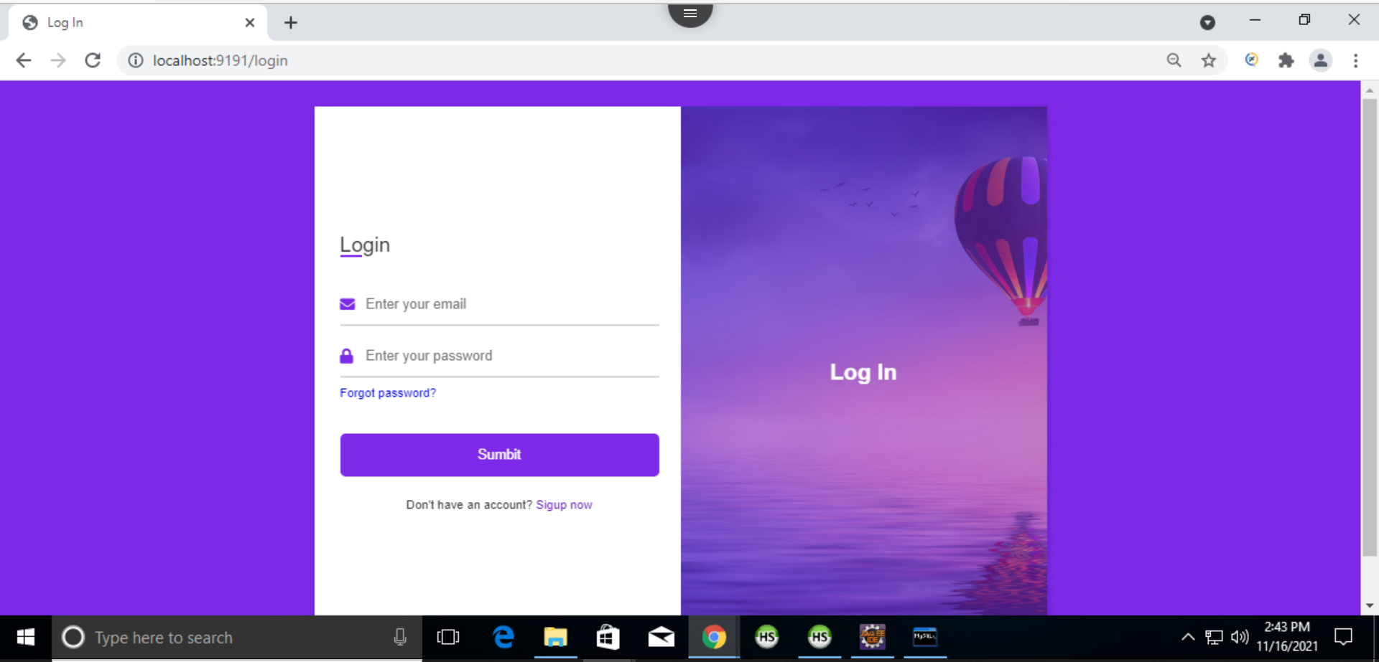

Slide 9
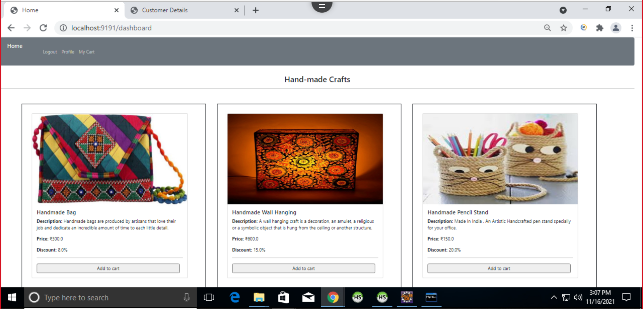

Slide 10
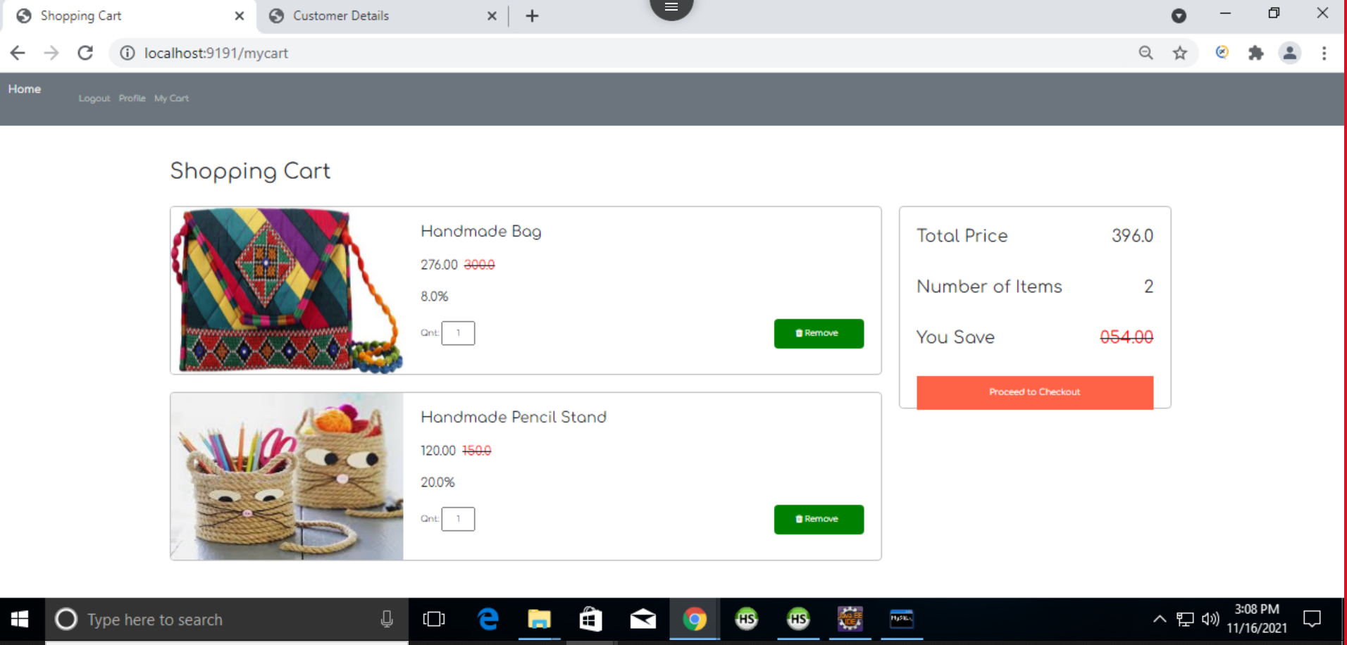

Slide 11
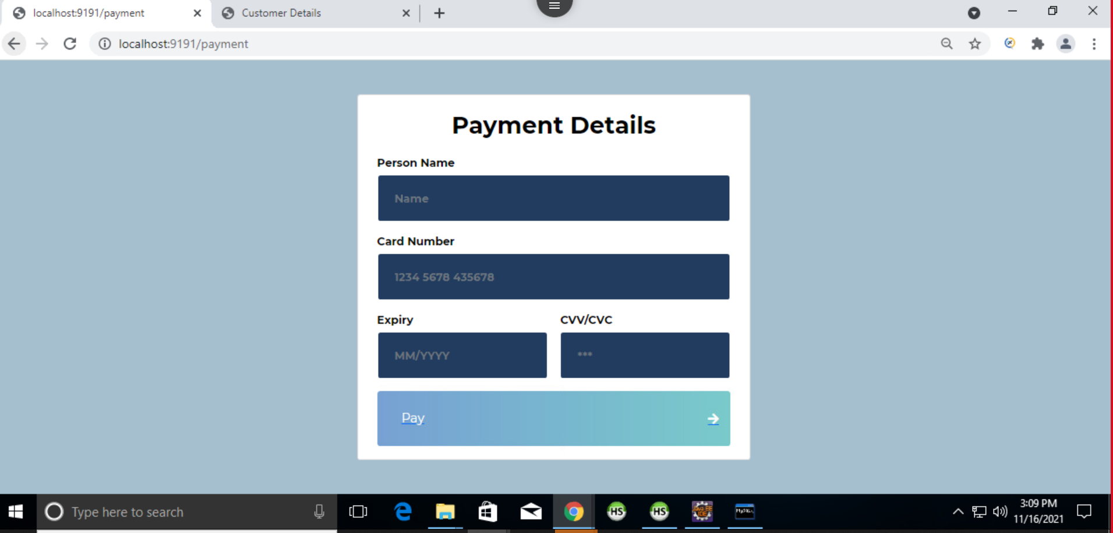

Slide 12
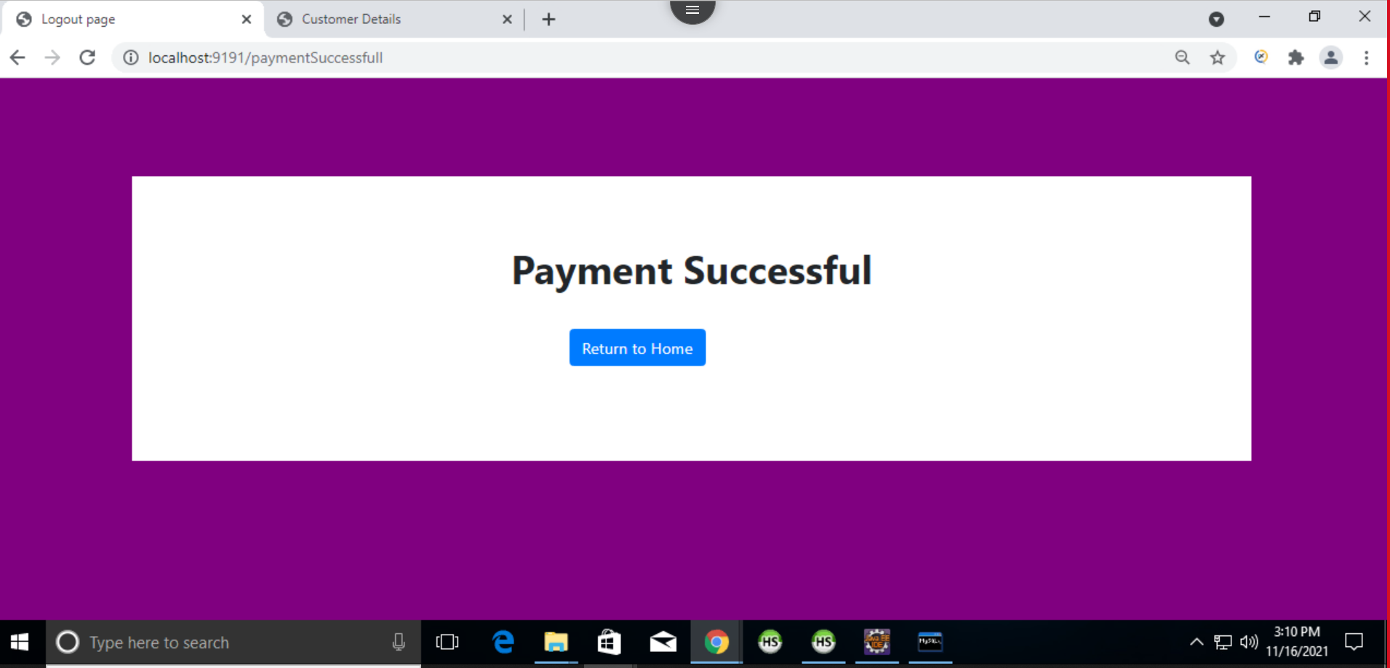

Slide 13
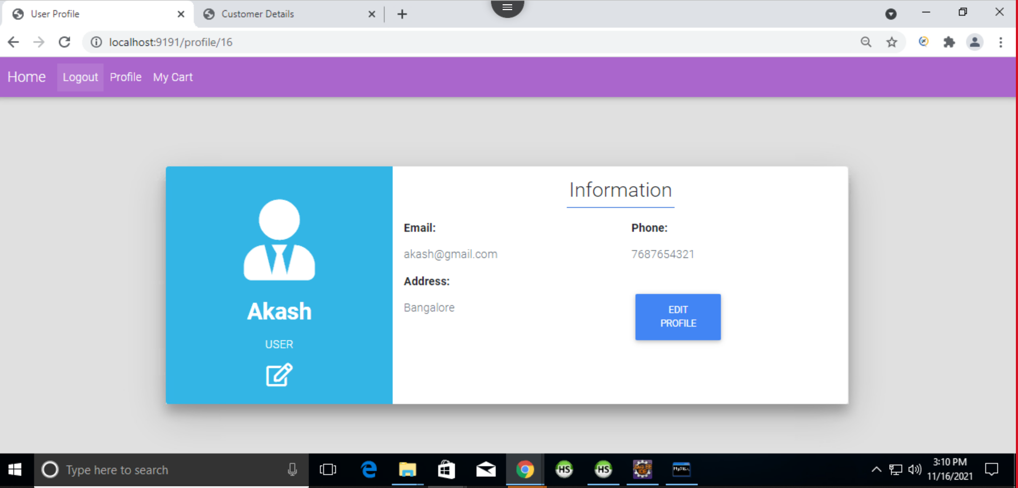

Slide 14
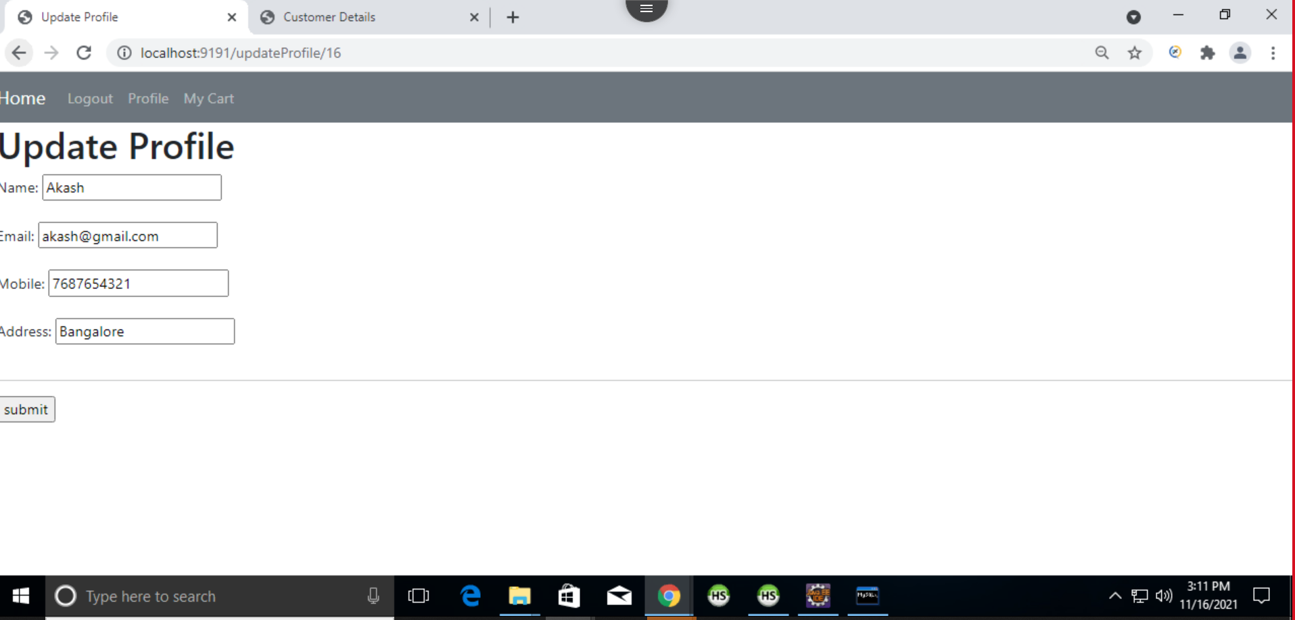

Slide 15
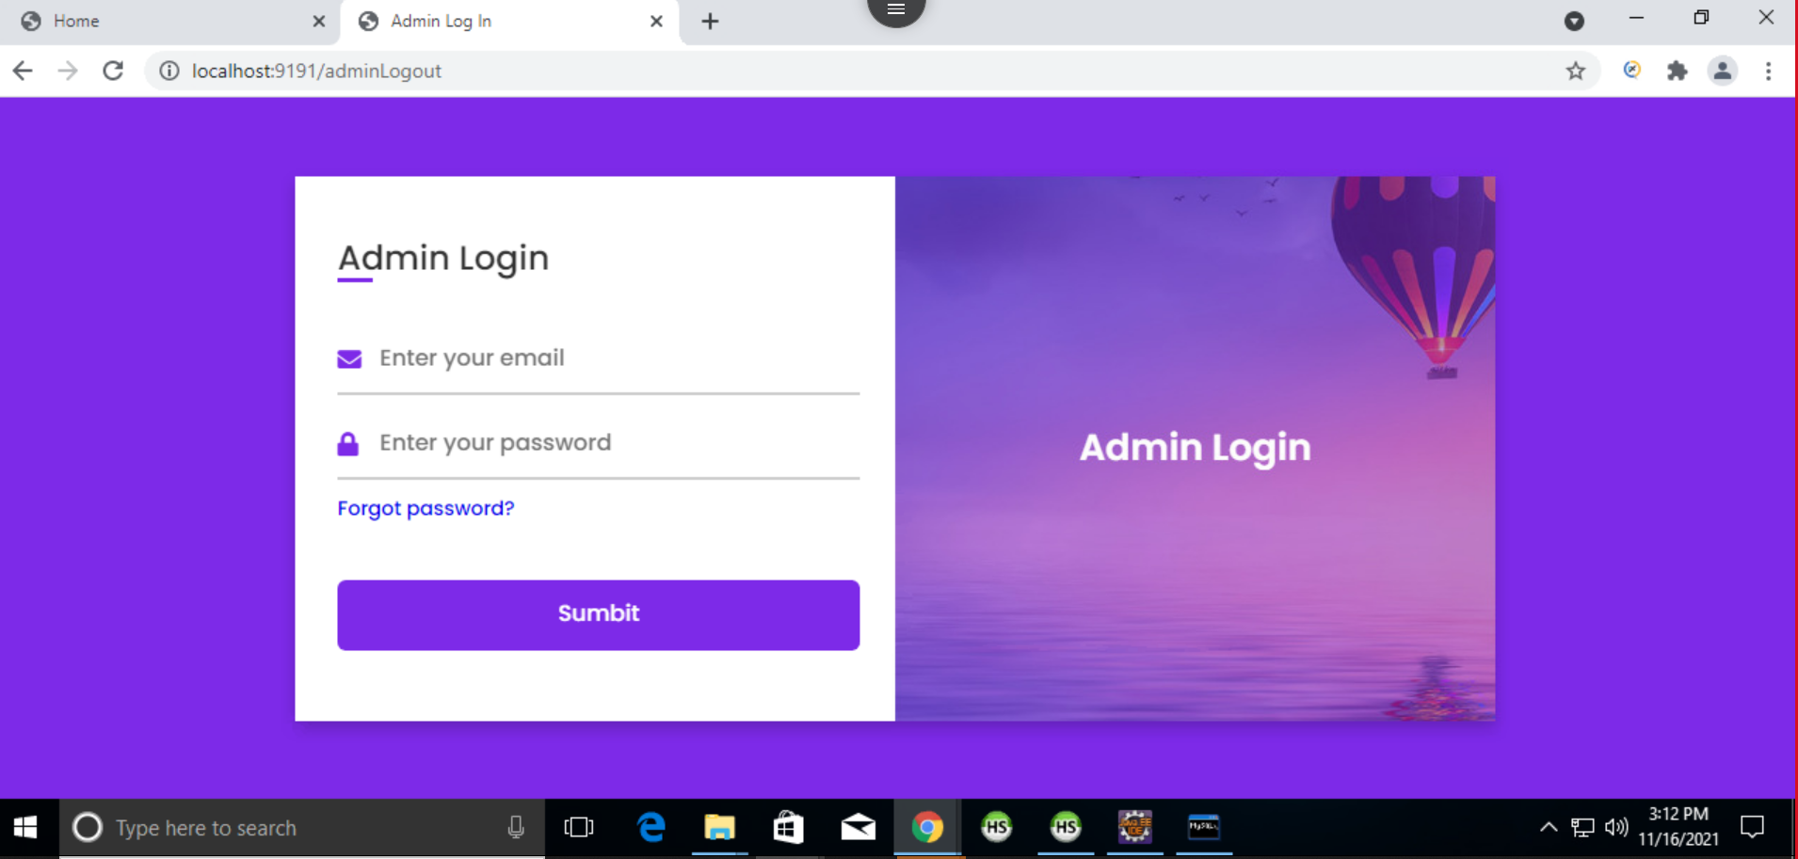

Slide 16
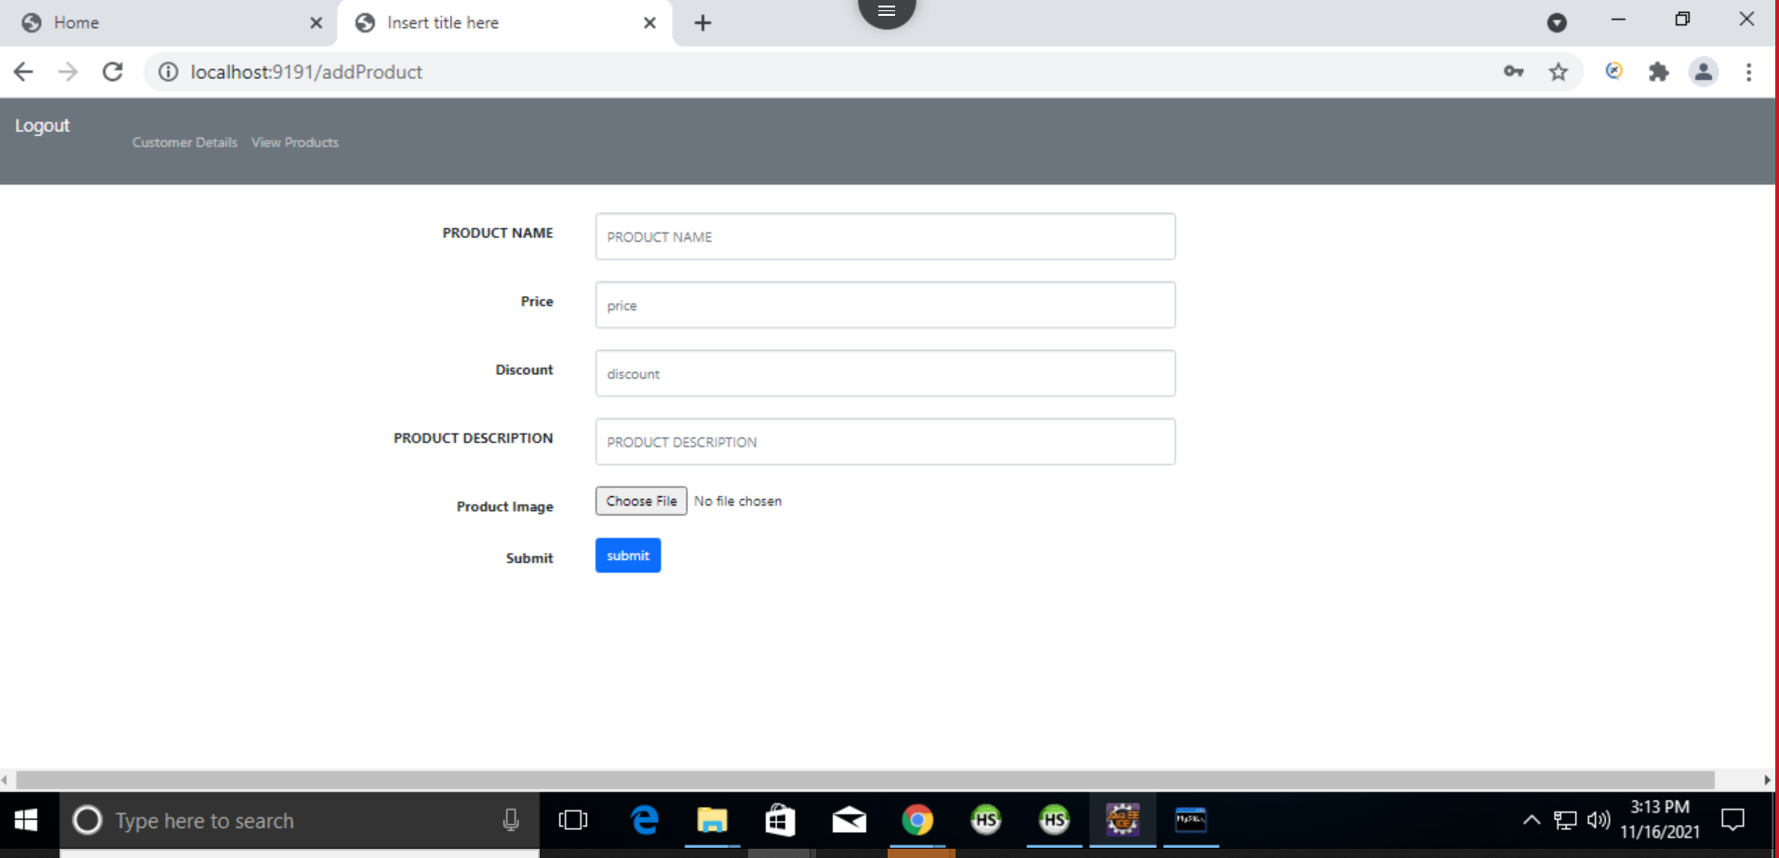

Slide 17
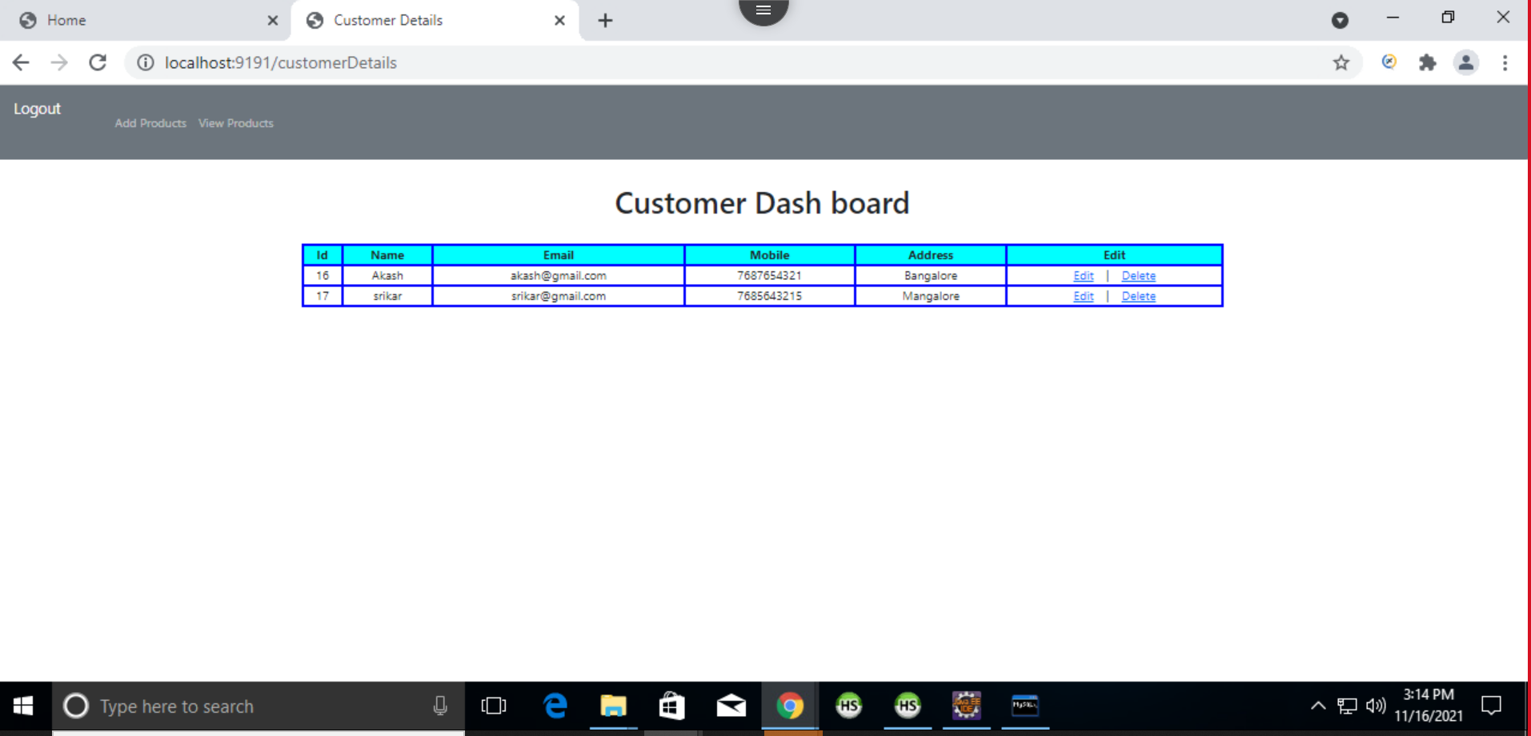

Slide 18
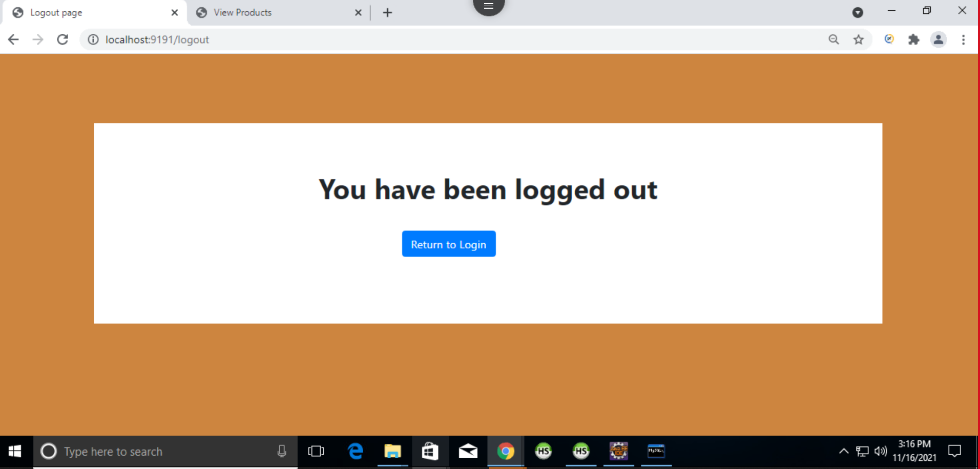

Slide 19
ROLES OF MEMBERS
Akash Anbalagan : Controller part in spring, Dashboard ,cart page && Admin page in frontend
Aman Deep : Model part in spring && Signup/login with validation in frontend
Pratishruti Panda : Service part in spring && Payment and Logout page in frontend
Srikar Kalle : Repository part in spring && Add product , profile page and admin page in frontend

Slide 20
ACKNOWLEDGEMENT
We would like to thanks our project guide Mr. Shadab for his guidance and support , which helped us a lot to learn the technology and able to make this project . Also special thanks to alchemy team for their providing us such a great platform for learning purpose.
Secondly we would like to thank Our Torry Harris Training Team for giving us this golden opportunity to learn and their recommendable support during this training period.

